Slide 1
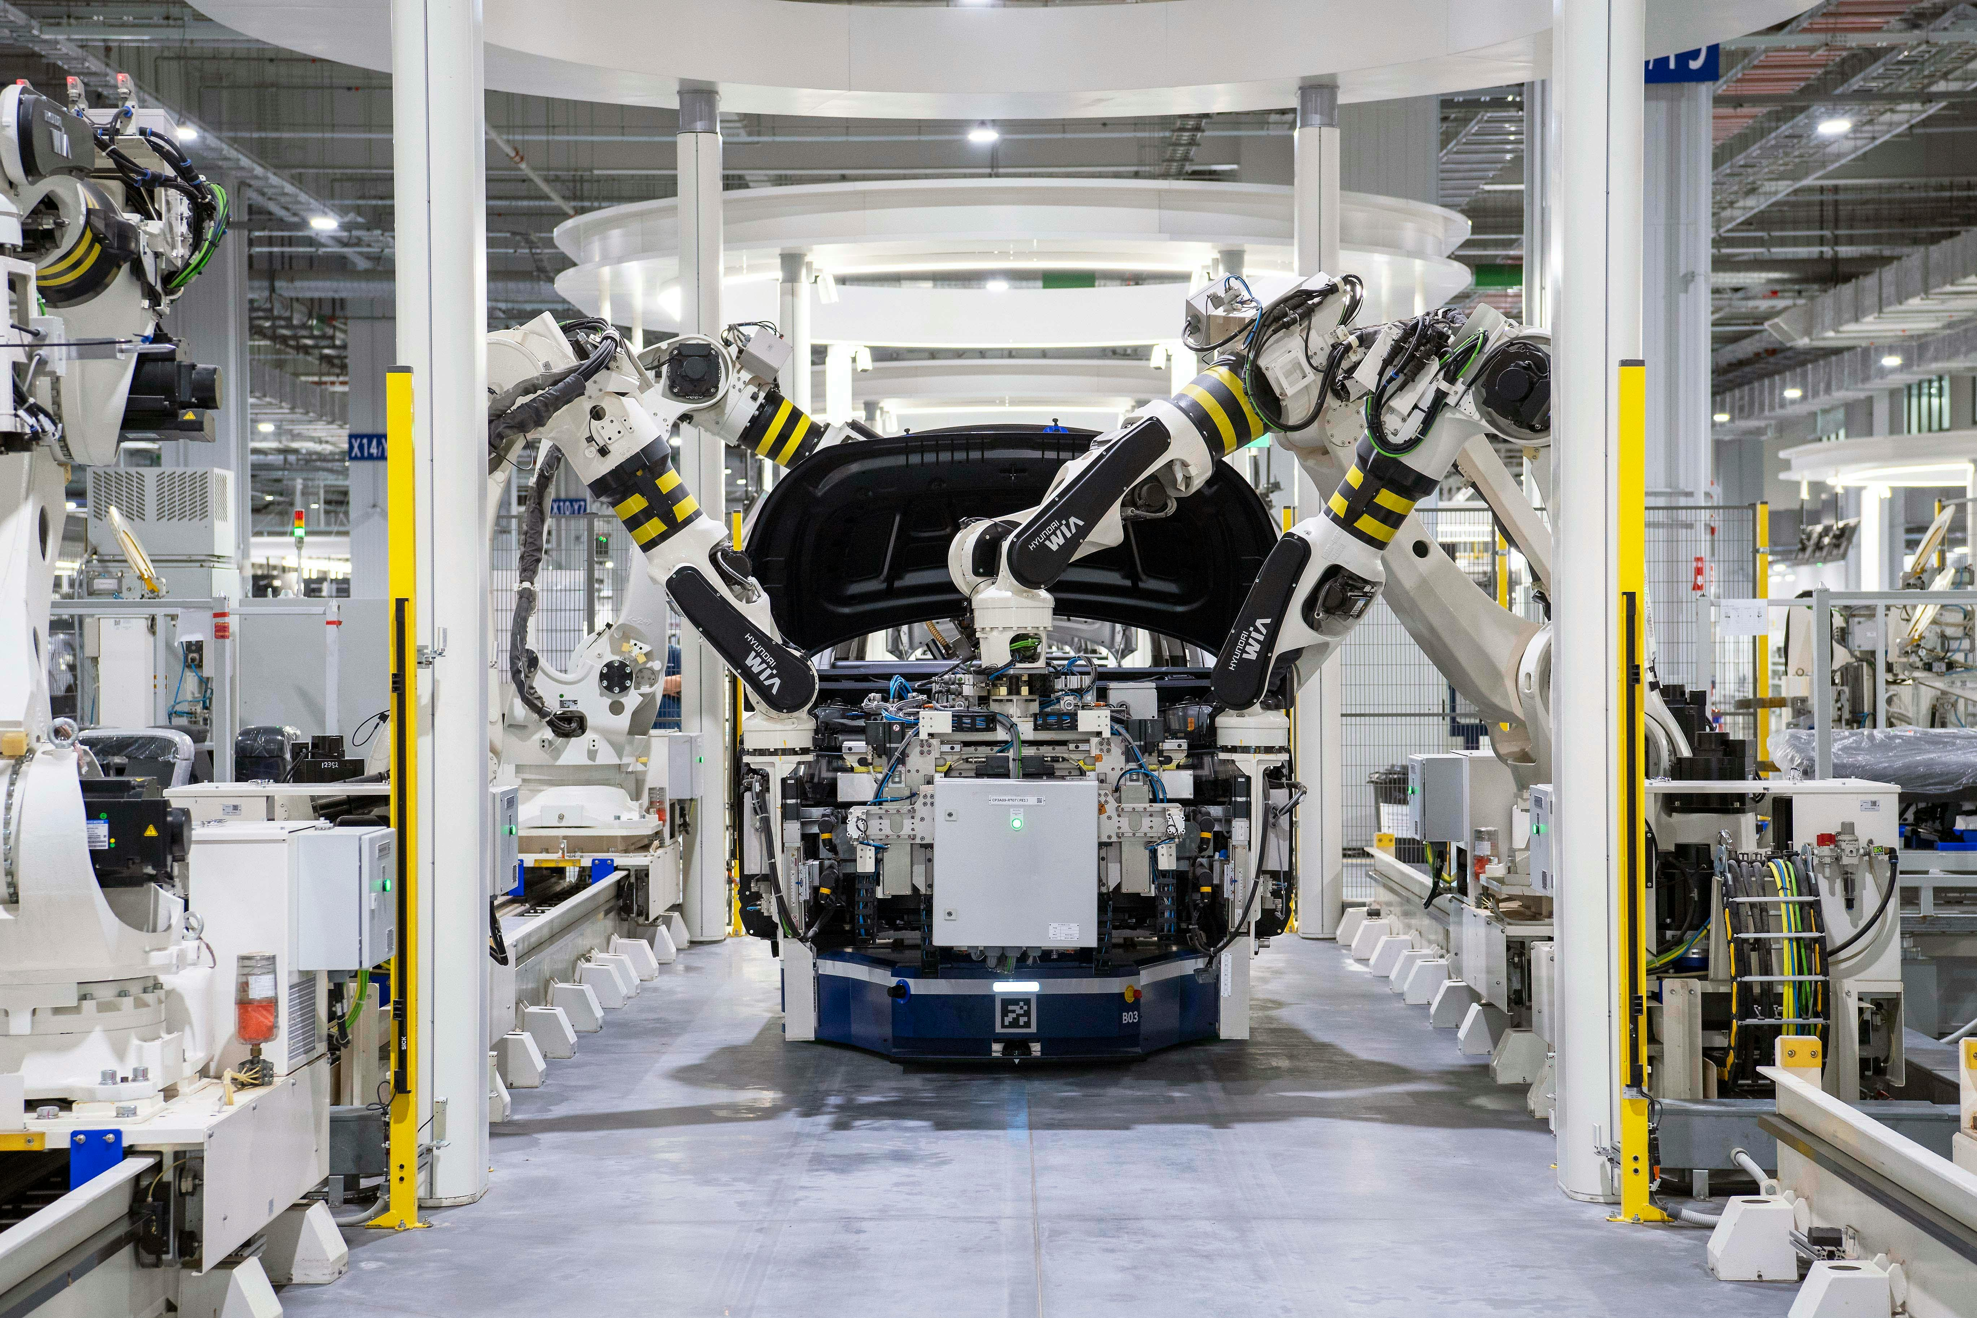


Senior Project
DESIGN CAMERA BASED SECURITY SYSTEM FOR INDUSTRIAL ROBOT
By Du Do Lan Chi – EEACIU19002 Advisor: Dr. Vo Tan Phuoc

Slide 2






Introduction
ISO 10218-1:2011
Camera as the sensor
Goal and Objectives
Develop a protective function to warning human.
Calibrate camera
Detect humans
Give warning signs

Slide 3
OUTLINE
DESIGN SPECIFICATION
LITERATURE REVIEW
METHODOLOGY
RESULT
DEMO

Slide 4
OUTLINE
DESIGN SPECIFICATION
LITERATURE REVIEW
METHODOLOGY
RESULT
DEMO
Hardware
Software

Slide 5
OUTLINE
DESIGN SPECIFICATION
LITERATURE REVIEW
METHODOLOGY
RESULT
DEMO
Image formation
Object detection
Pose estimation

Slide 6
OUTLINE
DESIGN SPECIFICATION
LITERATURE REVIEW
METHODOLOGY
RESULT
DEMO
Calibrate and undistort camera
Object detection: Human and ArUco marker
Estimate object’s poses and calculate distance

Slide 7
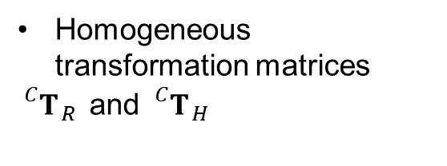
OUTLINE
DESIGN SPECIFICATION
LITERATURE REVIEW
METHODOLOGY
RESULT
Camera matrix
DEMO
Homogeneous transformation matrices
${}_{}^{C}{T_{ R }}$ and ${}_{}^{C}{T_{ H }}$
Final result: Distance and warning signs

Slide 8

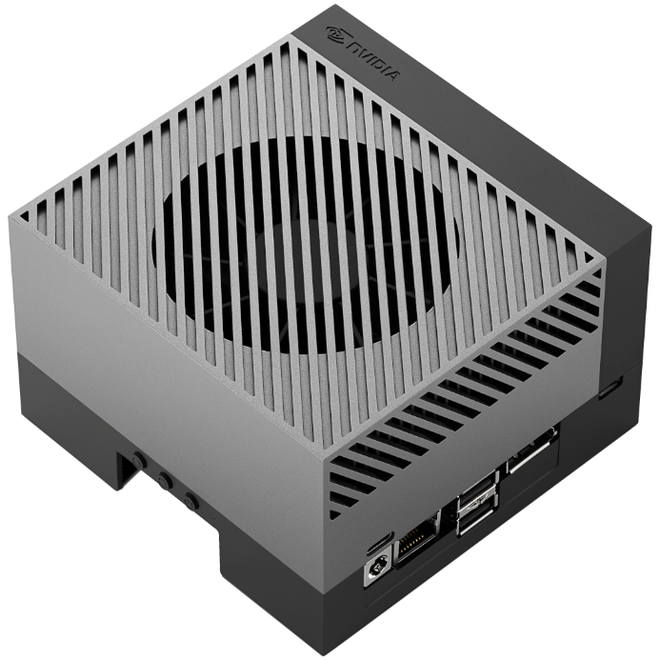

DESIGN SPECIFICATION
Programming language: Python
E-Dra EWC7700 webcam
Jetson AGX Orin

Slide 9
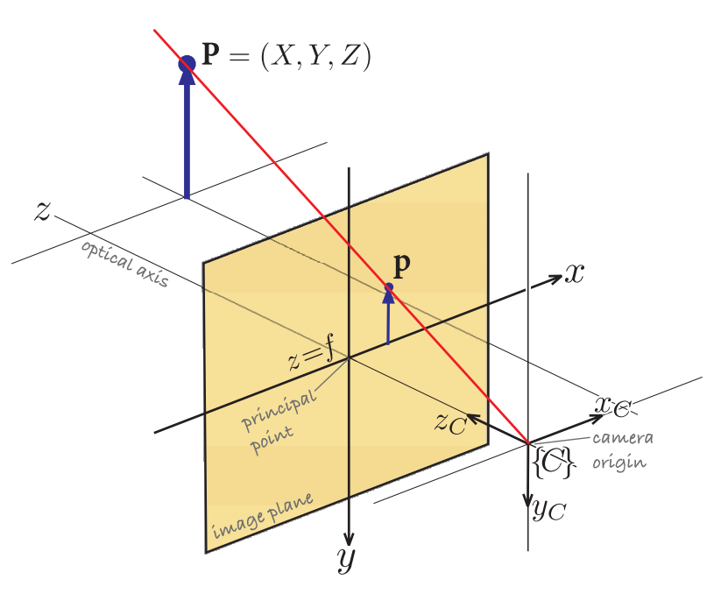
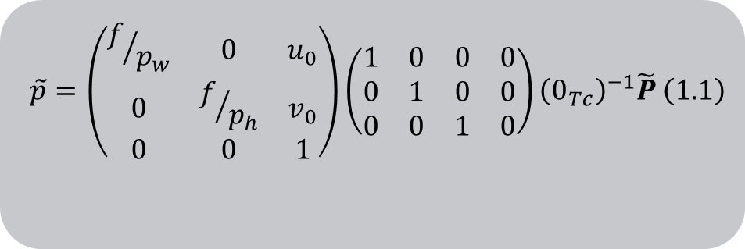

LITERATURE REVIEW
Camera projection:
1.1 Image Formation
$$\begin{aligned} \tilde{p}=\left(\begin{matrix}f/{p_{w}} & 0 & u_{0} \\ 0 & f/{p_{h}} & v_{0} \\ 0 & 0 & 1\end{matrix}\right)\left(\begin{matrix}1 & 0 & 0 & 0 \\ 0 & 1 & 0 & 0 \\ 0 & 0 & 1 & 0\end{matrix}\right){\left(0_{Tc}\right)}^{−1}\tilde{P} \#\left(1.1\right)\end{aligned}$$
intrinsic
extrinsic
Camera matrix:
$$\begin{aligned} C=\left[\begin{matrix}f_{x} & 0 & c_{x} \\ 0 & f_{y} & c_{y} \\ 0 & 0 & 1\end{matrix}\right] \#\left(1.2\right)\end{aligned}$$
Central projection model

Slide 10
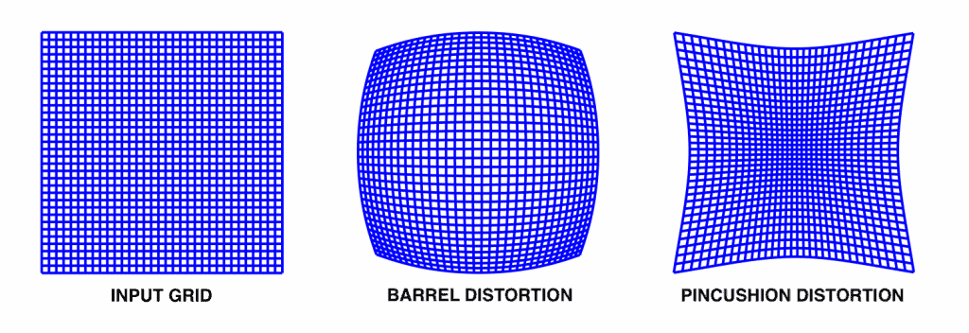
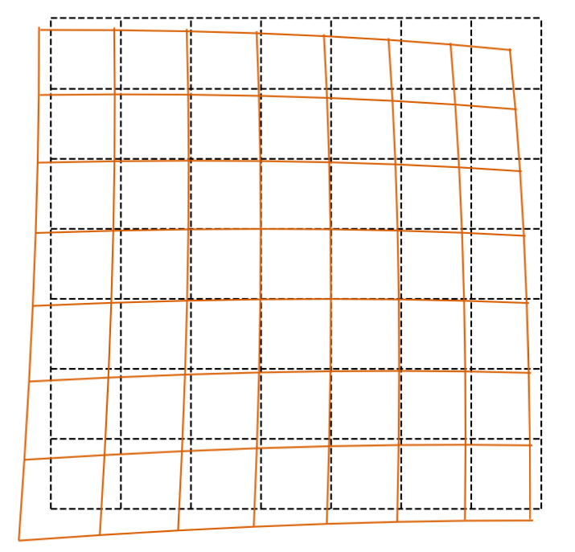
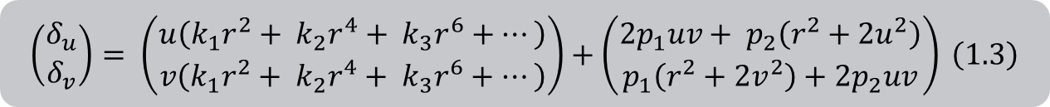

1.2 Distortion
Radial distortion
Tangential distortion
$$\begin{aligned} u^{d}=u+δ_{u},v^{d}=v+δ_{v},\end{aligned}$$
The displacement vector:
$$\begin{aligned} \left(\begin{matrix}δ_{u} \\ δ_{v}\end{matrix}\right)= \left(\begin{matrix}u\left(k_{1}r^{2}+ k_{2}r^{4}+ k_{3}r^{6}+…\right) \\ v\left(k_{1}r^{2}+ k_{2}r^{4}+ k_{3}r^{6}+…\right)\end{matrix}\right)+\left(\begin{matrix}2p_{1}uv+ p_{2}\left(r^{2}+2u^{2}\right) \\ p_{1}\left(r^{2}+2v^{2}\right)+2p_{2}uv\end{matrix}\right) \#\left(1.3\right)\end{aligned}$$
radial
tangential
Calibration: the process of figuring out these parameters with respect to the world coordinate system.

Slide 11
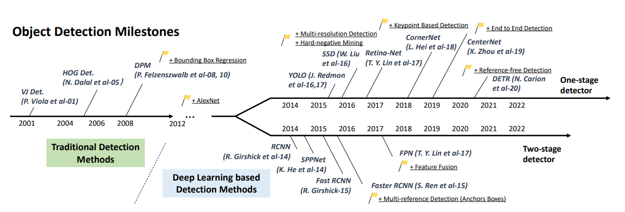
2 Object Detection
Histogram of Oriented Gradient
(HOG)
2005
2015
Single Shot MultiBox Detector
(SSD)

Slide 12
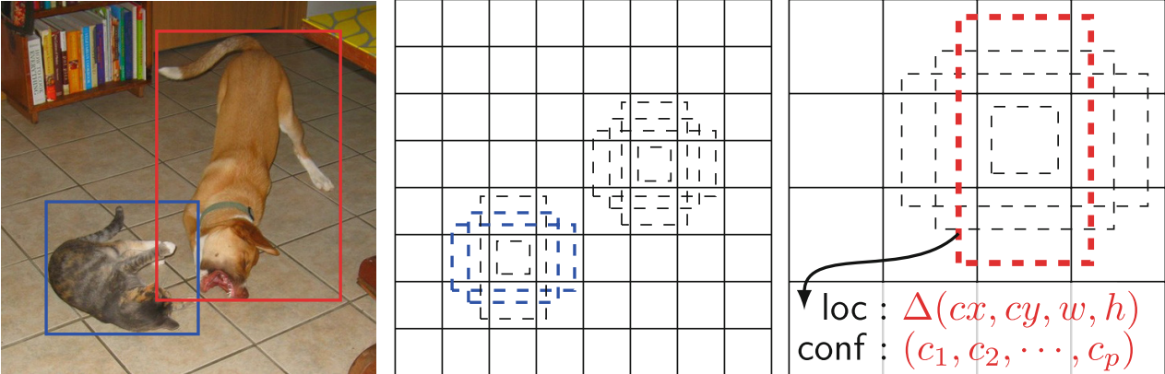
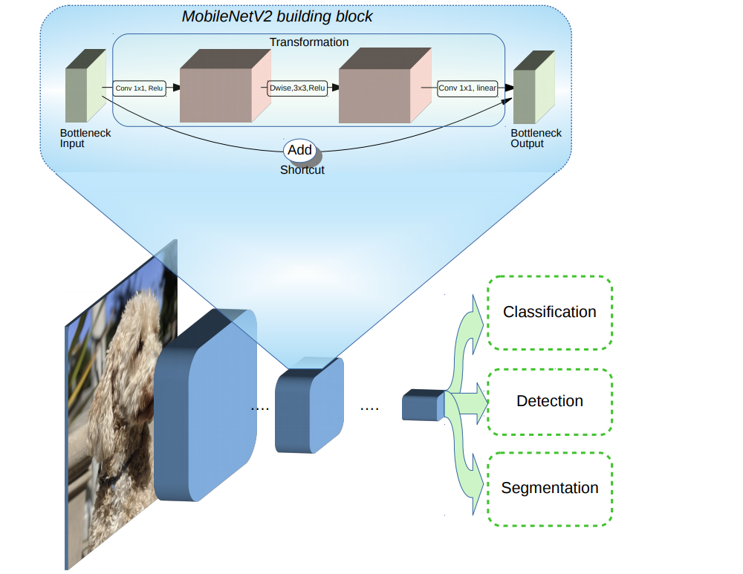
Single Shot MultiBox Detector
(SSD)
Detector: Use SSD MobileNet V2 to detect human.
MobileNet V2:

Slide 13
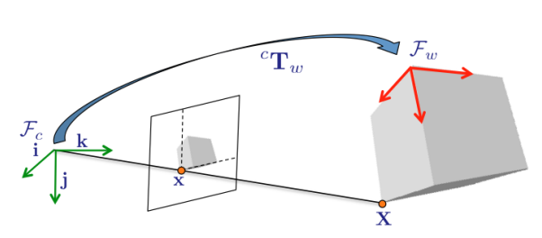
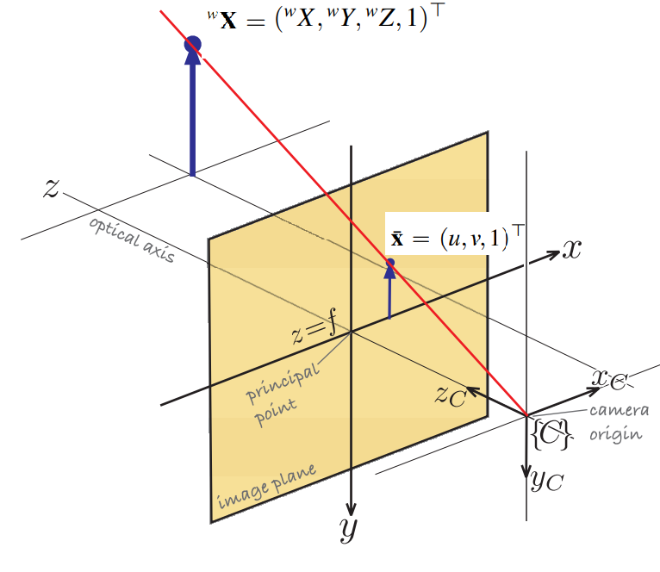
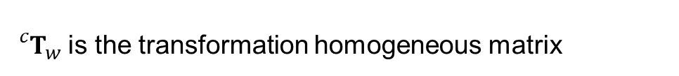
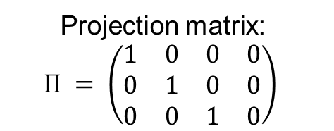

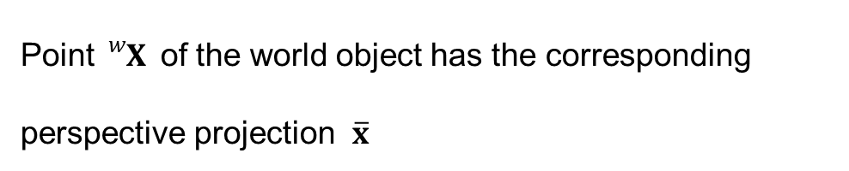


3 Pose Estimation
${{}_{}^{c}T}_{w}$ is the transformation homogeneous matrix
$$\begin{aligned} {{}_{}^{c}T}_{w}= \left(\begin{matrix}{{}_{}^{c}R}_{w} & {{}_{}^{c}t}_{w} \\ 0_{3×1} & 1\end{matrix}\right) \#\left(3.1\right)\end{aligned}$$
Point ${}_{}^{w}X$of the world object has the corresponding perspective projection $\overline{x}$
$$\begin{aligned} \overline{x}=KΠ{{}_{}^{c}T}_{w}{}_{}^{w}X \#\left(3.2\right)\end{aligned}$$
Projection matrix:
$$Π = \left(\begin{matrix}1 & 0 & 0 & 0 \\ 0 & 1 & 0 & 0 \\ 0 & 0 & 1 & 0\end{matrix}\right)$$
Camera matrix
Pose: having ${{}_{}^{c}T}_{w}$ by solving set of Eq. (3.2).

Slide 14
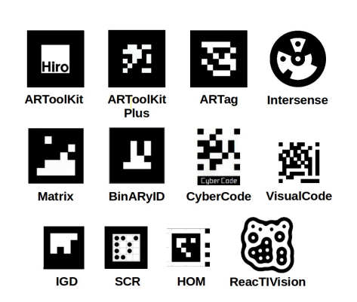
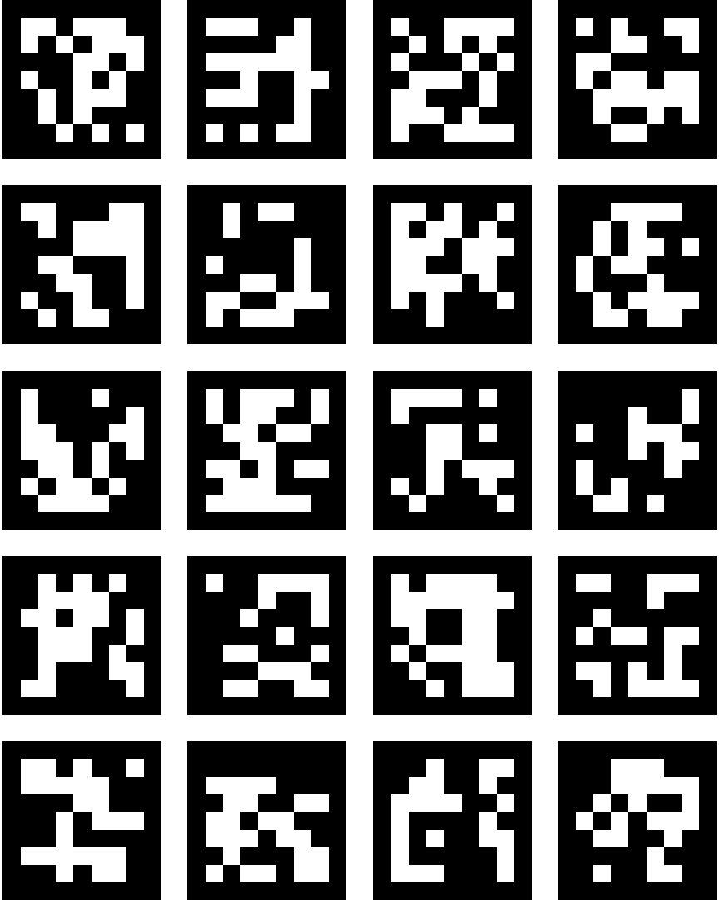
Fiducial marker
Reference objects
Square-based marker
One single marker is enough for pose estimation
Each marker utilizes identification through binary code
Each system has its own predefined set of marker
Problems: application’s requirements.
Aruco
Dictionaries with a desired quantity of markers and bits

Slide 15
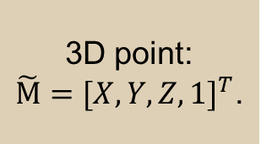
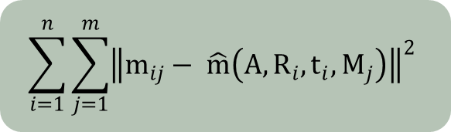
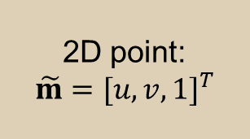
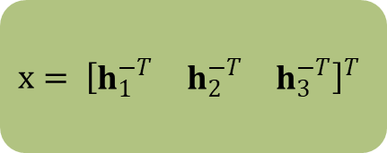
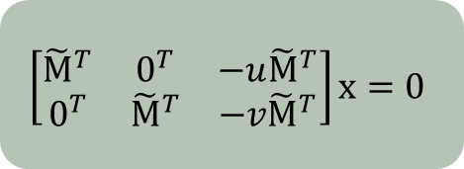
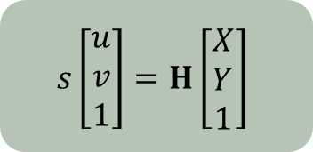
METHODOLOGY
1.1 Camera calibration
“A Flexible New Technique for Camera Calibration” method by Zhengyou Zhang
$$x= {\left[\begin{matrix}h_{1}^{−T} & h_{2}^{−T} & h_{3}^{−T}\end{matrix}\right]}^{T}$$
2D point:
$$\tilde{m}=[u, v{, 1]}^{T}$$
Maximum likelihood estimation
$$s\left[\begin{matrix}u \\ v \\ 1\end{matrix}\right]=H\left[\begin{matrix}X \\ Y \\ 1\end{matrix}\right]$$
$$\left[\begin{matrix}{\tilde{M}}^{T} & 0^{T} & −u{\tilde{M}}^{T} \\ 0^{T} & {\tilde{M}}^{T} & −v{\tilde{M}}^{T}\end{matrix}\right]x=0$$
$$\sum_{i=1}^{n}{\sum_{j=1}^{m}{{\left\|m_{ij}− \hat{m}\left(A, R_{i}, t_{i}, M_{j}\right)\right\|}^{2}}}$$
3D point:
$\tilde{M}=[X, Y,Z, 1]^{T}$.
SVD
H
Close form solution
Intrinsic parameters
Final results
Extrinsic parameters

Slide 16
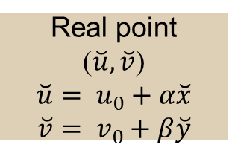
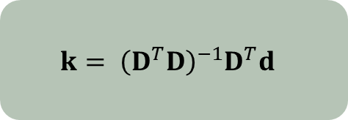
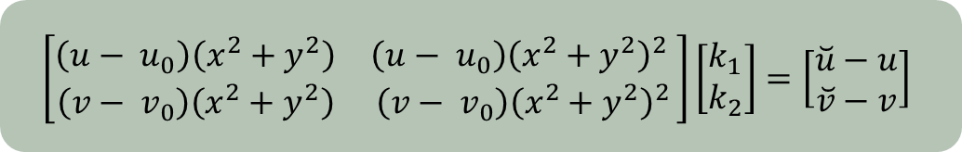
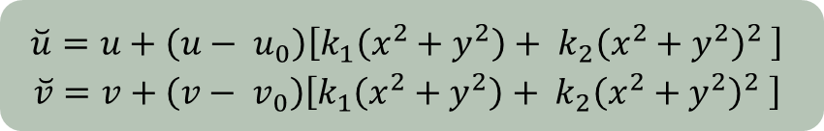
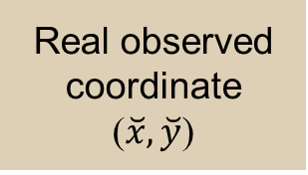
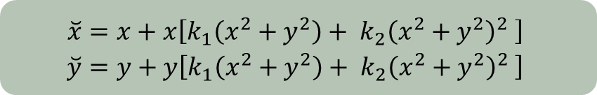
1.2 Distortion
Ideal image coordinate
(x, y)
Real observed coordinate
($\breve{x}, \breve{y}$)
Ideal point
(u, v)
Real point
($\breve{u}, \breve{v}$)
$$\breve{u}= u_{0}+α\breve{x}$$
$\breve{v}= v_{0}+β\breve{y}$
$$\begin{matrix}\breve{x}=x+x\left[k_{1}\left(x^{2}+y^{2}\right)+ {k_{2}\left(x^{2}+y^{2}\right)}^{2} \right] \\ \breve{y}=y+y\left[k_{1}\left(x^{2}+y^{2}\right)+ {k_{2}\left(x^{2}+y^{2}\right)}^{2} \right]\end{matrix}$$
$$\begin{matrix}\breve{u}=u+\left(u− u_{0}\right)\left[k_{1}\left(x^{2}+y^{2}\right)+ {k_{2}\left(x^{2}+y^{2}\right)}^{2} \right] \\ \breve{v}=v+\left(v− v_{0}\right)\left[k_{1}\left(x^{2}+y^{2}\right)+ {k_{2}\left(x^{2}+y^{2}\right)}^{2} \right]\end{matrix}$$
$$\left[\begin{matrix}\left(u− u_{0}\right)\left(x^{2}+y^{2}\right) & \left(u− u_{0}\right){\left(x^{2}+y^{2}\right)}^{2} \\ \left(v− v_{0}\right)\left(x^{2}+y^{2}\right) & \left(v− v_{0}\right){\left(x^{2}+y^{2}\right)}^{2}\end{matrix}\right]\left[\begin{matrix}k_{1} \\ k_{2}\end{matrix}\right]=\left[\begin{matrix}\breve{u}−u \\ \breve{v}−v\end{matrix}\right]$$
D
k
d
$$k= {\left(D^{T}D\right)}^{−1}D^{T}d$$
Linear least-square:

Slide 17
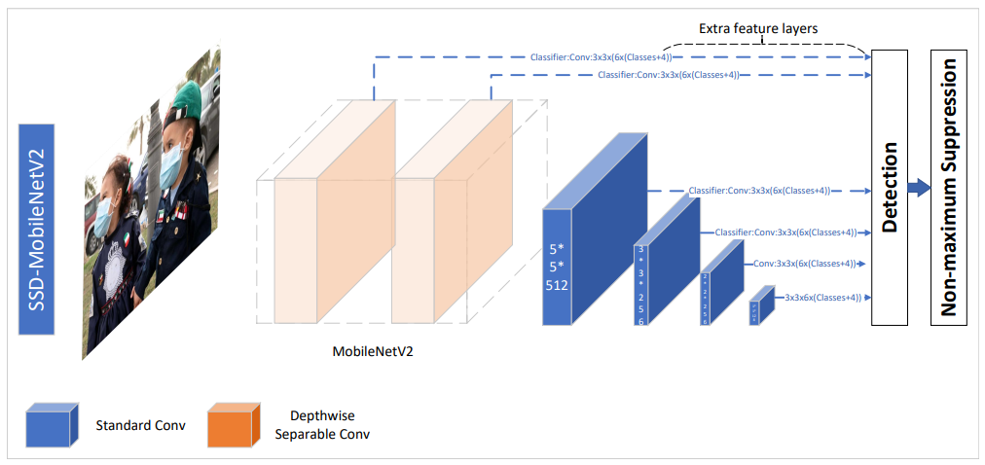

2 Object detection

Slide 18
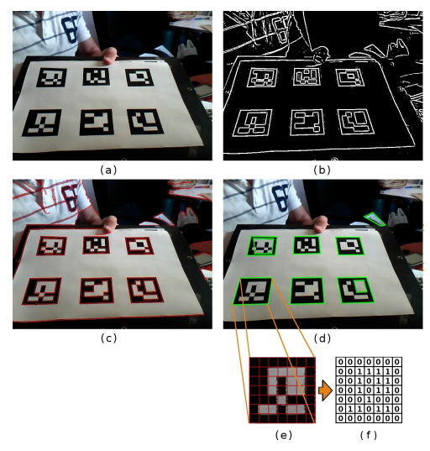
3.1 ArUco detection
- Detecting candidate:
Thresholding to isolate candidate
Contours lack of convexity or fail to approach a square-form are eliminated.
- Analyzing inner codification:
Otsu method: distinguish black and white bits
Bits are subjected for analysis

Slide 19

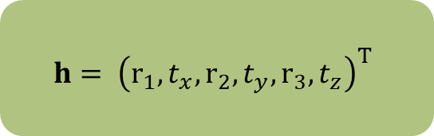

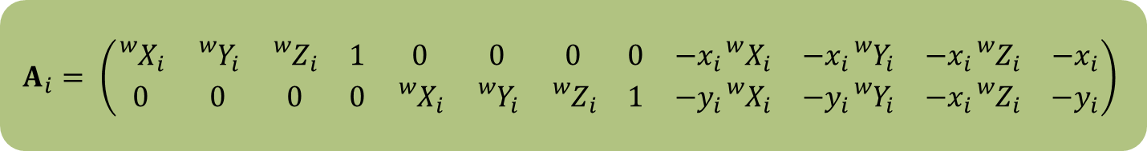
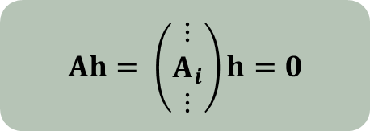
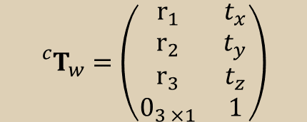
3.2 Solving pose estimation from N point corresponding
(PnP)
$${}_{}^{c}{T_{w}}=\left(\begin{matrix}r_{1} & t_{x} \\ r_{2} & t_{y} \\ r_{3} & t_{z} \\ 0_{3 ×1} & 1\end{matrix}\right)$$
The homogeneous matrix ${}_{}^{c}{T_{w}}$ :
Projection point described by world point :
$x_{i}= Π {{}_{}^{c}T}_{w}{{}_{}^{w}X}_{i}$
$$A_{i}= \left(\begin{matrix}{}_{}^{w}{X_{i}} & {}_{}^{w}{Y_{i}} & {}_{}^{w}{Z_{i}} & 1 & 0 & 0 & 0 & 0 & −x_{i}{}_{}^{w}{X_{i}} & −x_{i}{}_{}^{w}{Y_{i}} & −x_{i}{}_{}^{w}{Z_{i}} & −x_{i} \\ 0 & 0 & 0 & 0 & {}_{}^{w}{X_{i}} & {}_{}^{w}{Y_{i}} & {}_{}^{w}{Z_{i}} & 1 & −y_{i}{}_{}^{w}{X_{i}} & −y_{i}{}_{}^{w}{Y_{i}} & −x_{i}{}_{}^{w}{Z_{i}} & −y_{i}\end{matrix}\right)$$
$Ah= \left(\begin{matrix}⋮ \\ A_{i} \\ ⋮\end{matrix}\right)h=0$
$$h= {\left(r_{1}, t_{x}, r_{2}, t_{y}, r_{3}, t_{z}\right)}^{T}$$
Solving SVD of A

Slide 20
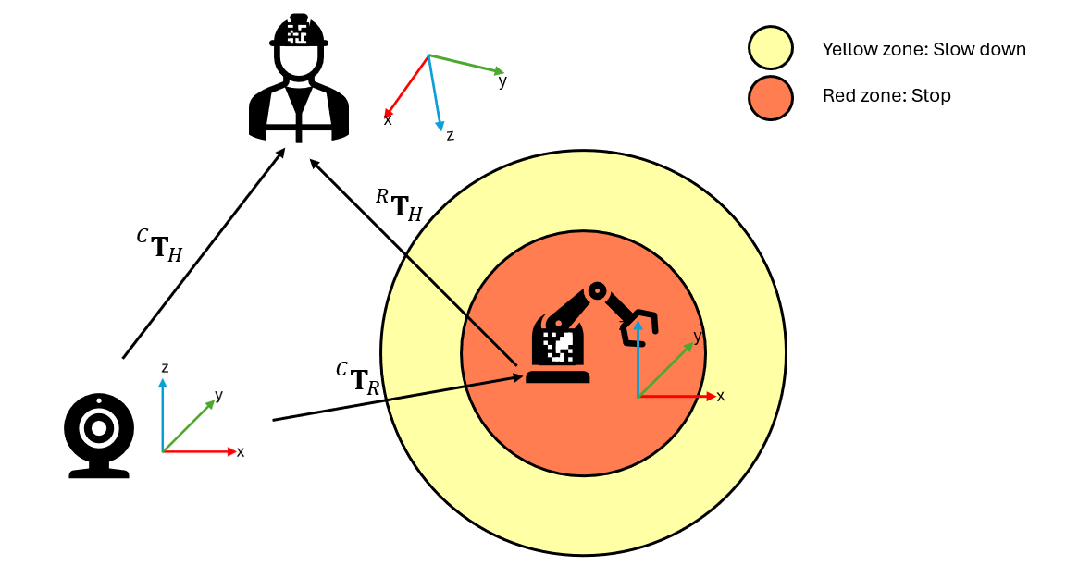
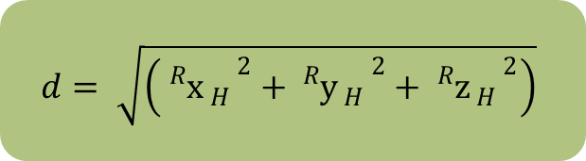
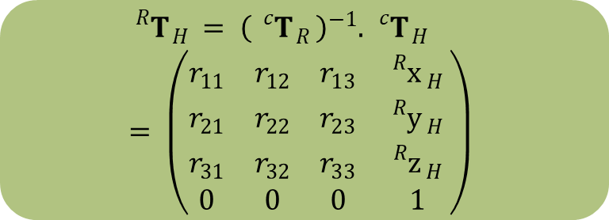
3.3 Distance and warning signs
$${}_{}^{R}{T_{ H }}= {\left({}_{}^{c}{T_{ R }}\right)}^{−1}. {}_{}^{c}{T_{ H }}= \left(\begin{matrix}r_{11} & r_{12} & r_{13} & {}_{}^{R}{x_{ H }} \\ r_{21} & r_{22} & r_{23} & {}_{}^{R}{y_{ H }} \\ r_{31} & r_{32} & r_{33} & {}_{}^{R}{z_{ H }} \\ 0 & 0 & 0 & 1\end{matrix}\right)$$
$$d= \sqrt{\left({{}_{}^{R}{x_{ H }}}^{2}+{{}_{}^{R}{y_{ H }}}^{2}+{{}_{}^{R}{z_{ H }}}^{2}\right)}$$

Slide 21
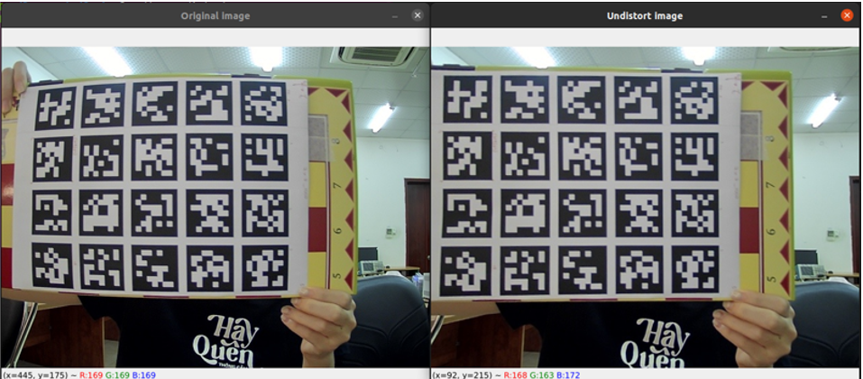
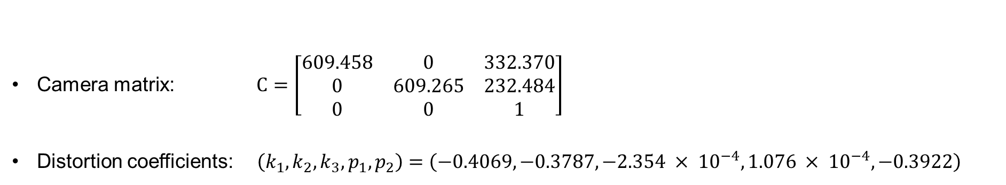
RESULT
Camera matrix: $C=\left[\begin{matrix}609.458 & 0 & 332.370 \\ 0 & 609.265 & 232.484 \\ 0 & 0 & 1\end{matrix}\right]$
Distortion coefficients: $\left(k_{1}, k_{2}, k_{3}, p_{1}, p_{2}\right)=\left(−0.4069, −0.3787, −2.354 × {10}^{−4}, 1.076 × {10}^{−4}, −0.3922\right)$

Slide 22
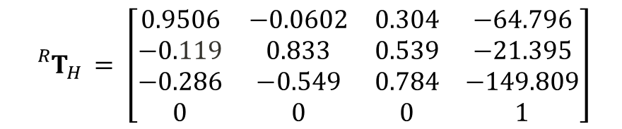
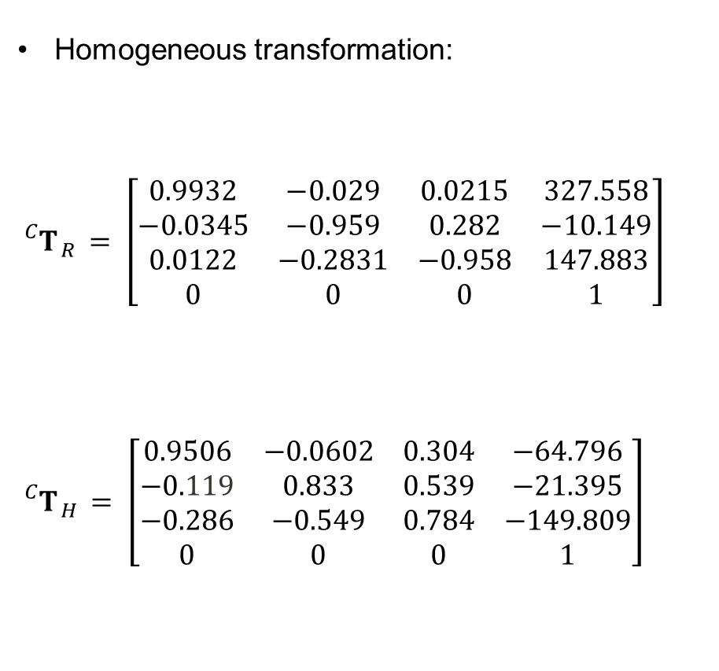
Homogeneous transformation:
$${}_{}^{C}{T_{ R }}= \left[\begin{matrix}0.9932 & −0.029 & 0.0215 & 327.558 \\ −0.0345 & −0.959 & 0.282 & −10.149 \\ 0.0122 & −0.2831 & −0.958 & 147.883 \\ 0 & 0 & 0 & 1\end{matrix}\right]$$
$${}_{}^{C}{T_{ H }}= \left[\begin{matrix}0.9506 & −0.0602 & 0.304 & −64.796 \\ −0.119 & 0.833 & 0.539 & −21.395 \\ −0.286 & −0.549 & 0.784 & −149.809 \\ 0 & 0 & 0 & 1\end{matrix}\right]$$
$${}_{}^{R}{T_{H }}= \left[\begin{matrix}0.9506 & −0.0602 & 0.304 & −64.796 \\ −0.119 & 0.833 & 0.539 & −21.395 \\ −0.286 & −0.549 & 0.784 & −149.809 \\ 0 & 0 & 0 & 1\end{matrix}\right]$$

Slide 23
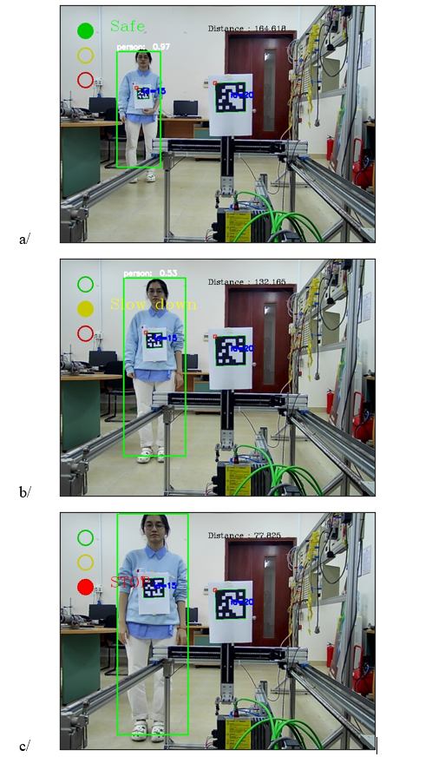

Slide 24
DEMO

Slide 25
REFERENCE
[1] P. Corke, Robotics Vision and Control, Springer, 2017.
[2] B. T. Navneet Dalal, "Histograms of Oriented Gradients for Human Detection," International Conference on Computer Vision & Pattern Recognition (CVPR ’05), San Diego, 2005.
[3] D. A. D. E. C. S. S. R. C.-Y. F. a. A. C. B. Wei Liu, "SSD: Single Shot MultiBox Detector," Springer, 2016.
[4] A. H. M. Z. A. Z. L.-C. C. Mark Sandler, "MobileNetV2: Inverted Residuals and Linear Bottlenecks," Google Inc., 2019.
[5] H. U. F. S. Eric Marchand, " Pose Estimation for Augmented Reality: A Hands-On Survey," IEEE Transactions on Visualization and Computer Graphics, 2016.
[6] Z. Zhang, "A Flexible New Technique for Camera Calibration," ResearchGate, 1998.

Slide 26
v

